Slide 1

RFP No. 1902 Processed USDA Foods
Products and Commercial Equivalents
Super Co-Op Price Catalog for SY 2019-20
Welcome to the Bidder’s Webinar
February 7, 2019 – 10:00AM

Slide 2
Welcome
“Listen only” mode
Registration for the webinar and log-on is proof of attendance
Enter questions anytime during the webinar on the right side of your screen
Q & A posted on Super Co-Op website
  Monday, February 11 as “Addendum A”

Slide 3
RFP for SY 2019-20
RFP #1902
  Price Catalog – formerly Market Basket
  Not intended for direct delivery sales
  Only manufacturers awarded on this solicitation will be eligible for Pass Through Value to co-op members

Slide 4
Important Dates
Bidders Conference Webinar
  Thursday February 7, 2019
  10:00 AM
Addendum A
  Bidders Conference Q & A
  Posted on website Monday, February 11, 2019
Responses due @ Santa Clarita, CA
  Wednesday, March 6, 2019 @ 1:00 PM PT
Public Opening @ Santa Clarita, CA
  Thursday, March 7, 2019 @ 10:00AM PT

Slide 5
RFP No. 1902 - Processed USDA Foods & Commercial Equivalents
RFP document
Information Submission Worksheet (Excel format)
Addendum A
Available at www.super-coop.org

Slide 6

RFP No. 1902
Pricing for 2019-20 school year
Original signatures required

Slide 7
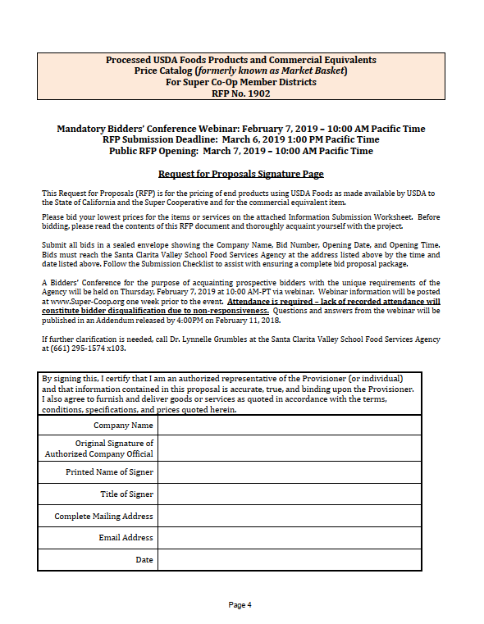
Request for Proposal
Signature Page -
Page 4
Return completed hard copy with original signature
Return scanned copy of signed document

Slide 8
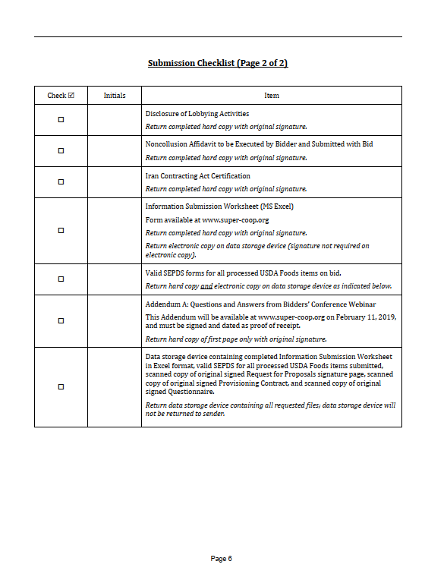
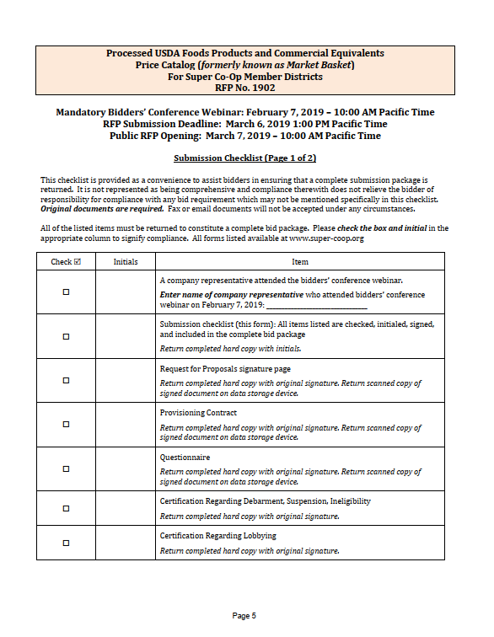
Bidders Checklist
Two Pages
Pages 5-6
Insert name of company representative attending this webinar

Slide 9
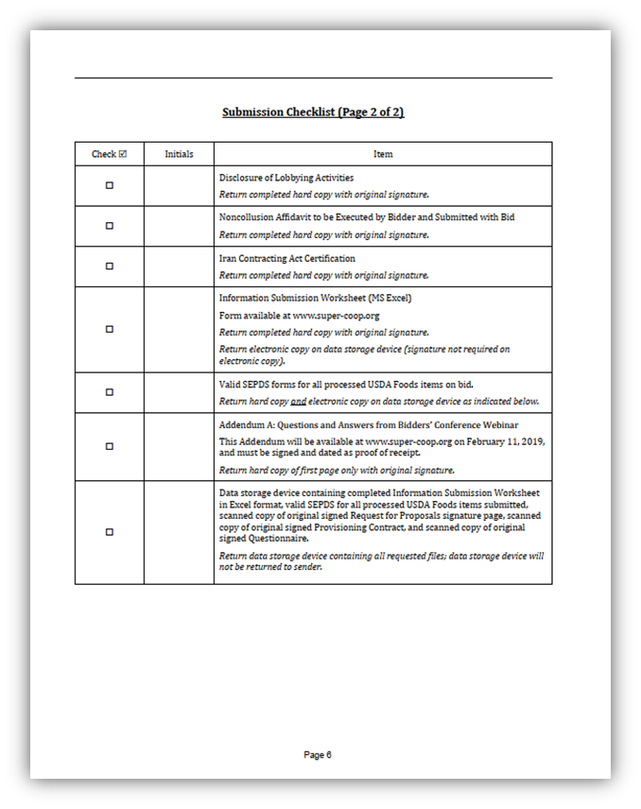
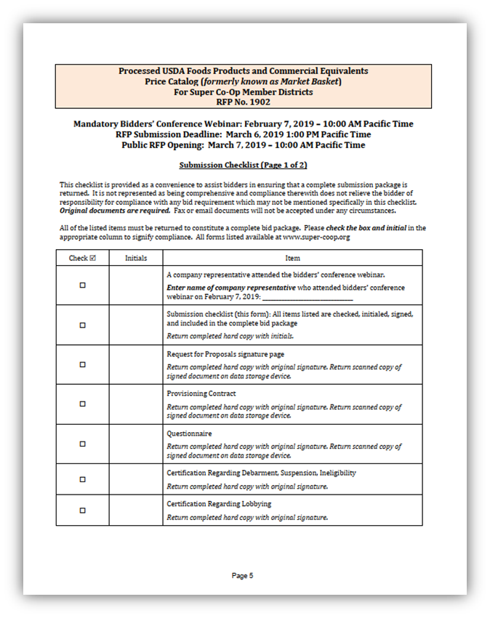

Bidders Checklist
Two Pages
Pages 5-6
Return completed hard copy with initials


Slide 10
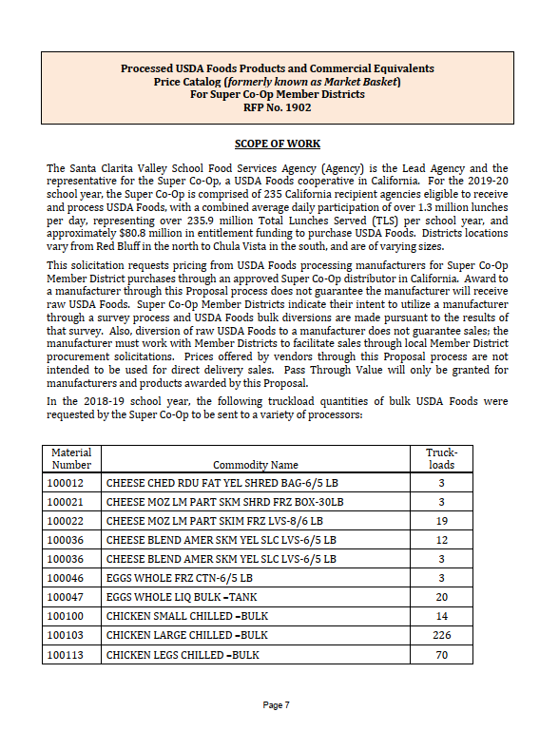
Scope of Work-
Pages 7-8
235 members
$80.8 million entitlement
Diversions for current year

Slide 11
Scope of Work-
Pages 7-8
Manufacturer to distributor pricing
Diversions based on member requests
  Annual survey will be open for our members over the next two weeks

Slide 12
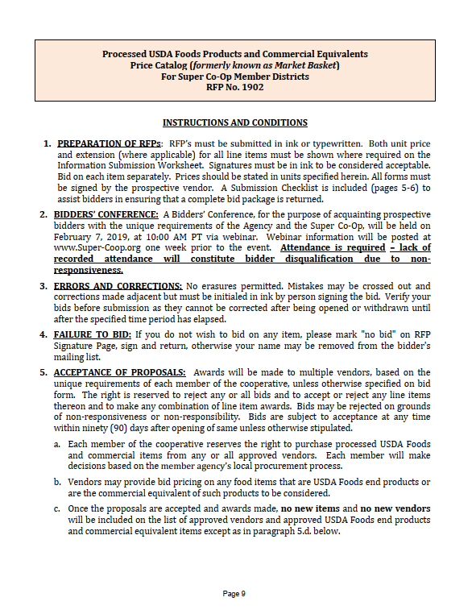
Instructions and Conditions
Pages 9-13
  Read carefully

Slide 13
Instructions and Conditions
Pages 9-13
All documents must be submitted in ink or typewritten
Original signatures required
No erasures, cross out mistakes and initial
Pricing for 2019-20 school year
  FOB approved distributor or manufacturer
  Direct to member district not authorized by contract

Slide 14
Instructions and Conditions
Pages 9-13
Paragraph 6, page 10
Transfer of Title must be in conformance with 7 CFR 250.11(e)

Slide 15
Instructions and Conditions
Pages 9-13
Paragraph 7: USDA Foods End Product Sales Reports and Sales Verification
  Must be submitted daily
  Electronic submission
  Third party okay, approved format
Questionnaire response (pages 17-19)
  Company owned website
  Third party clearinghouse
Vendor fully responsible
  For cost and transmissions
Carry-over balances
  Report to Administrator by August 31, 2020

Slide 16
Instructions and Conditions
Pages 9-13
Paragraph 8: Agreements Between Processors and Distributors
7 CFR Part 210.30(i)
Written contracts required between an end product processor and distributor
Agreements must reference sales reporting frequency, requirements in 250.11, and value pass through system.

Slide 17
Instructions and Conditions
Pages 9-13
Paragraph 25: Buy American Provision
7CFR Part 210.21(d)
Agricultural commodity produced in U.S.
Food product processed in U.S. substantially using agricultural commodities produced in the U.S.

Slide 18
Instructions and Conditions
Pages 9-13
Paragraph 25: Buy American Provision
Indicate whether product meets definition
  Information Submission Worksheet
  Questionnaire page 17 - #4

Slide 19
Instructions and Conditions
Pages 9-13
Paragraph 26: SEPDS
Submit SEPDS forms for all items offered
Updates to Lead Agency within 10 days of publication
If SEPDS not approved yet, submit EPDS or a letter explaining where your forms are in the approval process.
Forward finalized SEPDS as soon as available.

Slide 20
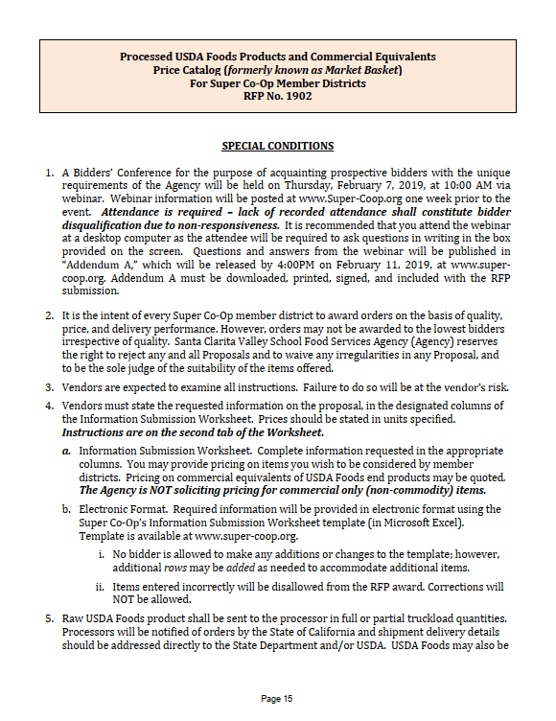
Special
Conditions
Pages 15-16
Read carefully

Slide 21
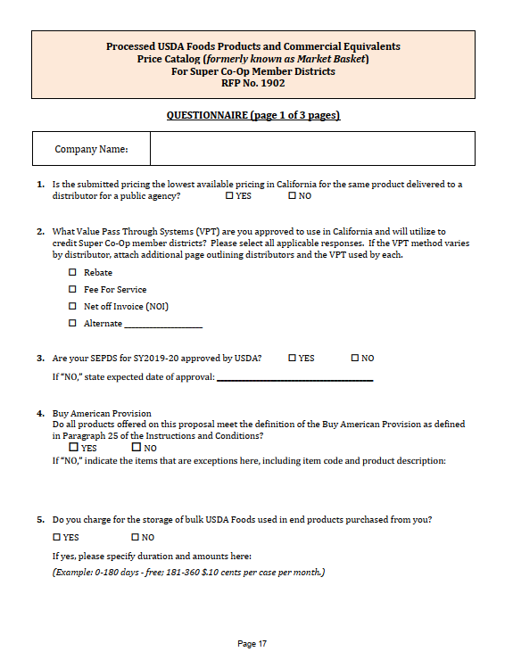
Questionnaire
Pages 17-19
Respond to all questions as requested

Slide 22
Questionnaire
Pages 17-19
Respond to all questions as requested
Buy American Provision #4

Slide 23
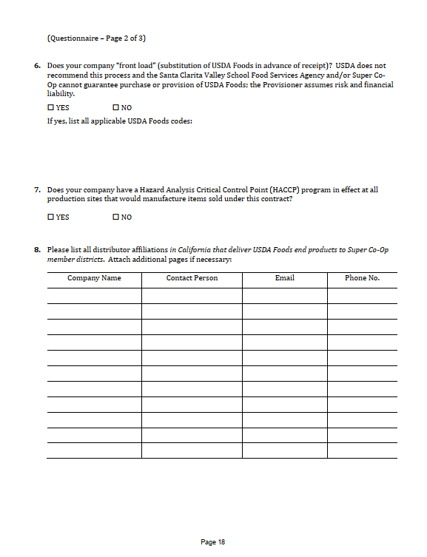
Questionnaire
Pages 17-19
Respond to all questions as requested

Slide 24
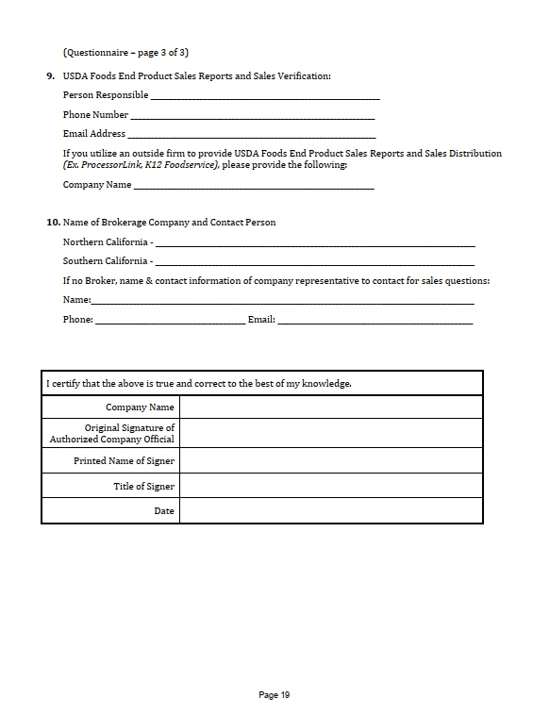
Questionnaire
Pages 17-19
Return completed hard copy with original signature
Return scanned copy of signed document

Slide 25
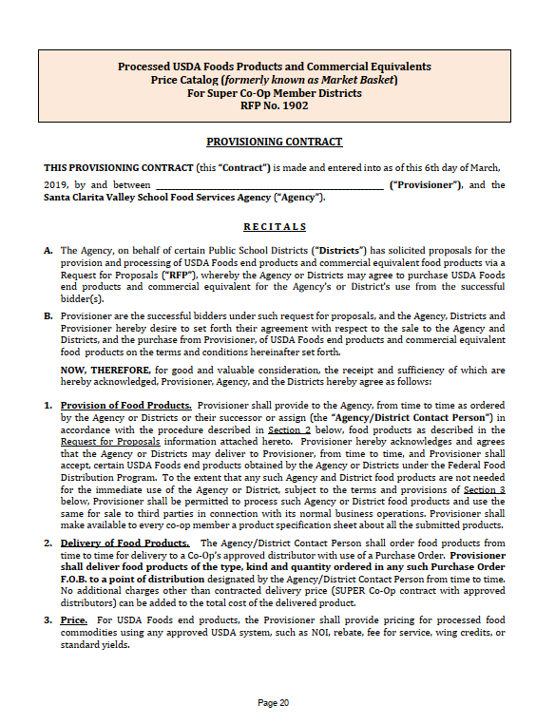
Provisioning Contract
Pages 20-25
Insert company name on first page

Slide 26
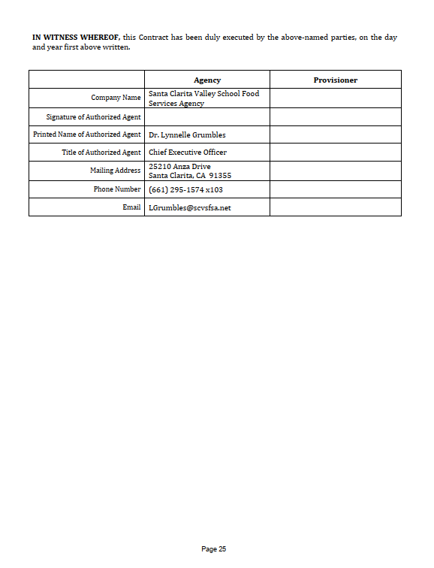
Provisioning Contract
Signature Page
Page 25
Return completed hard copy with original signature.
Return scanned copy of signed document.

Slide 27
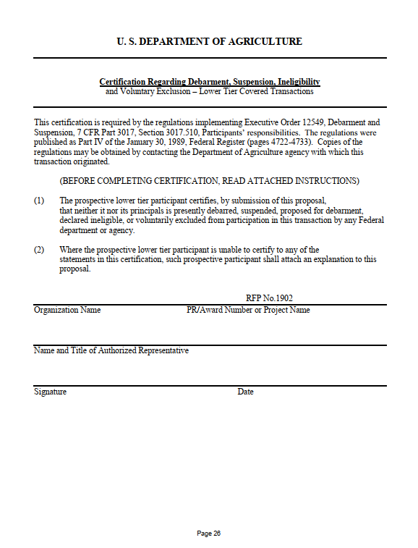
Certification Regarding Debarment,
Suspension,
Ineligibility
Page 26
Return completed hard copy with original signature.
Instructions on page 27.

Slide 28
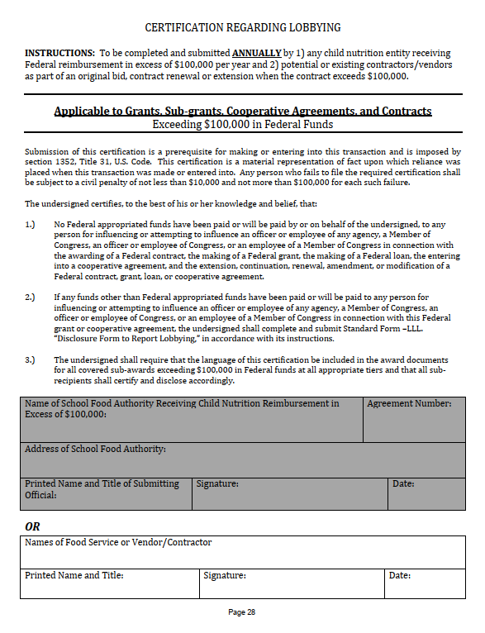
Certification Regarding Lobbying
Page 28
Return completed hard copy with original signature.

Slide 29
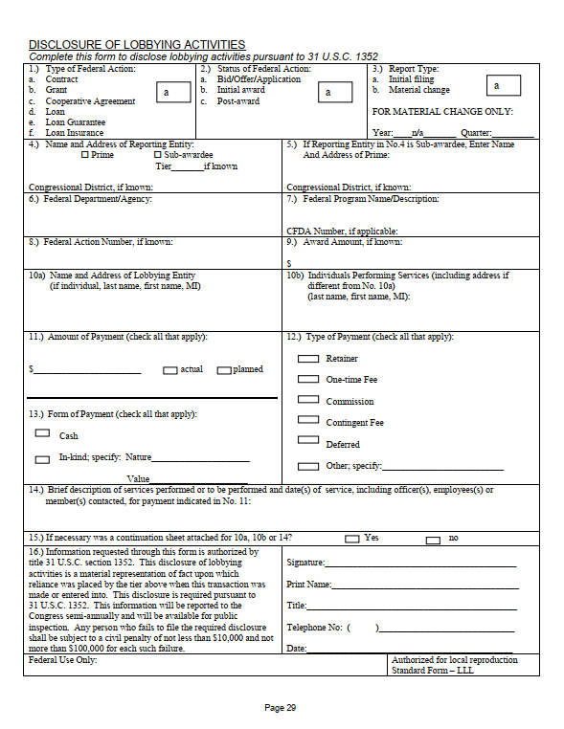
Disclosure of Lobbying Activities
Page 29
Return completed hard copy with original signature.

Slide 30
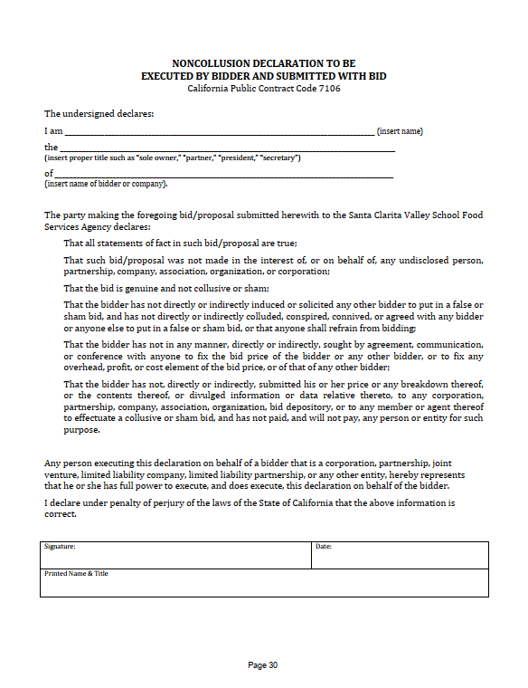
Noncollusion Declaration
Page 30
Return completed hard copy with original signature.
Notarization NOT required.

Slide 31
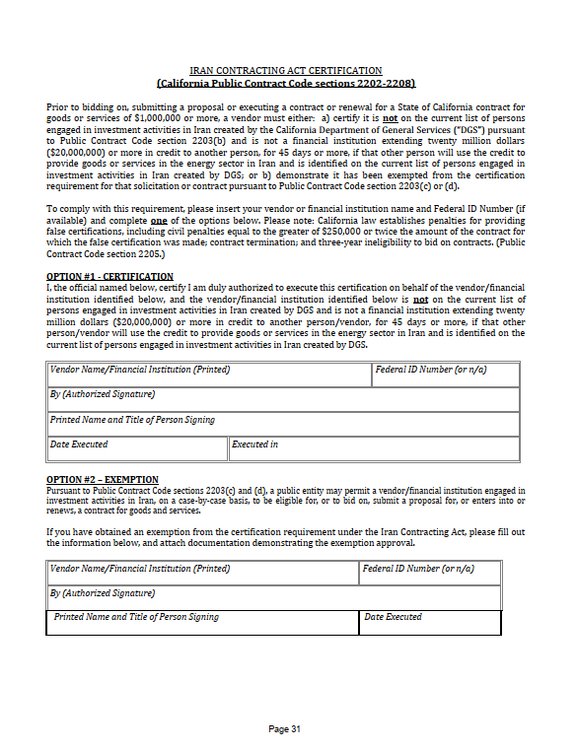
Iran Contracting Act Certification
Page 31
Return completed hard copy with original signature.

Slide 32
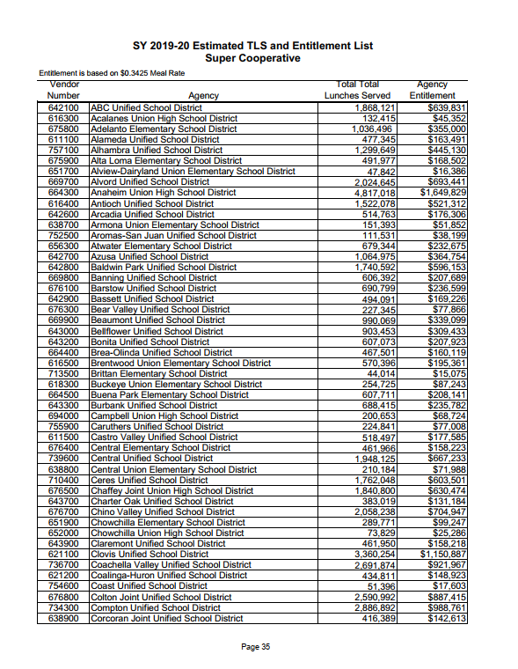
Attachment A:
List of Member
Districts for
SY 2018-19
Pages 35-39

Slide 33
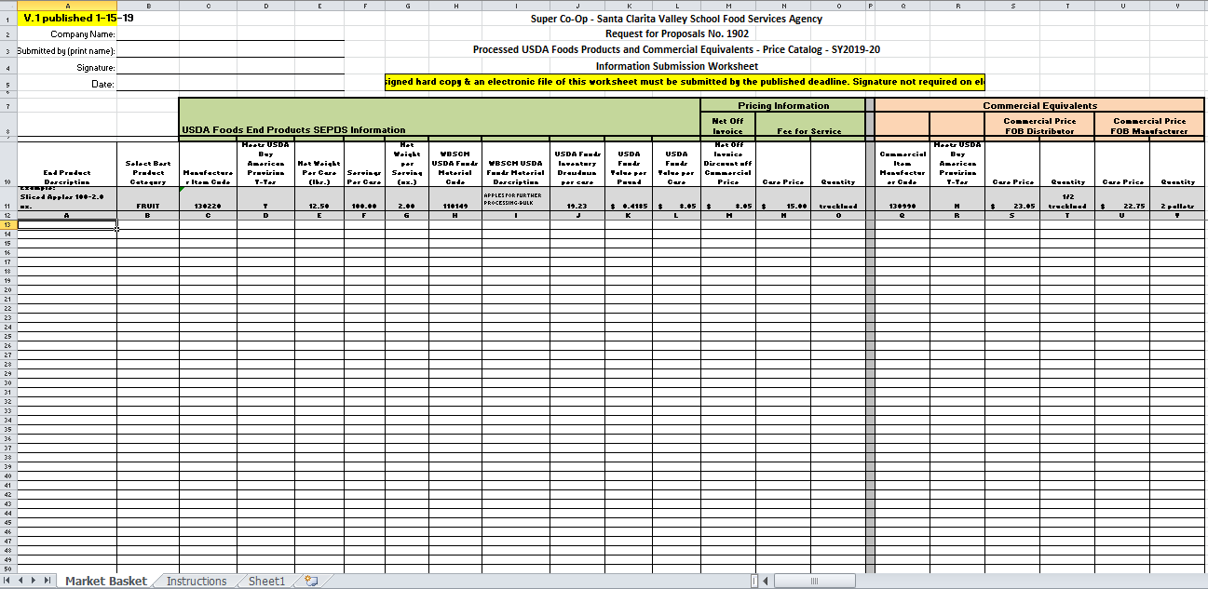
Information Submission Worksheet
Excel Format

Slide 34
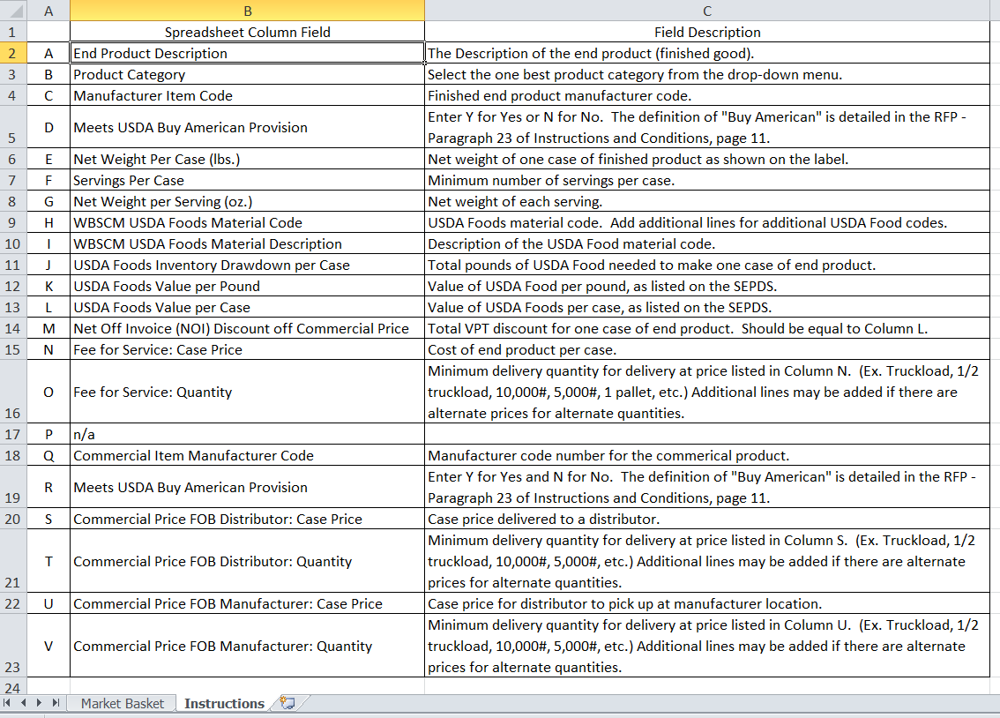
Instructions Tab

Slide 35
Item Description & Best Category

Slide 36
USDA Foods End Products – SEPDS Info

Slide 37
Buy American Provision – Y=Yes, N=No

Slide 38
Two Pricing Sections

Slide 39
Commercial Equivalents

Slide 40
Buy American Provision – Y=Yes, N=No

Slide 41
Signature & Requested Information
Return completed hard copy with original signature
Return digital copy on data storage device
Signature not required on digital copy

Slide 42
QUESTIONS?
Type questions into Q & A box at your right
Additional Written Questions can be sent to
Lynnelle Grumbles
LGrumbles@scvsfsa.net
Before 5:00PM today

Slide 43
Complete Bid Packet
Bidder checklist
  All items listed are checked & initialed
  Return completed hard copy with initials
Request for Proposal signature page
  Return completed hard copy with original signature & scanned copy of signed document
Provisioning Contract
  Return completed hard copy with original signature & scanned copy of signed document

Slide 44
Complete Bid Packet
Questionnaire
  Return completed hard copy with original signature & scanned copy of signed document
Certification Regarding Debarment, Suspension, Ineligibility
  Return completed hard copy with original signature
Certification Regarding Lobbying
  Return completed hard copy with original signature

Slide 45
Complete Bid Packet
Disclosure of Lobbying Activities
  Return completed hard copy with original signature
Noncollusion Declaration ☑Return completed hard copy with original signature
Iran Contracting Act Certification
  Return completed hard copy with original signature
Addendum A: Questions and Answers from Bidder’s Conference Webinar
  This Addendum will be available at www.super-coop.org by February 11, 2019 and must be signed and dated as proof of receipt.
  Return hard copy with original signature

Slide 46
Complete Bid Packet
Information Submission Worksheet (MS Excel)
  Return completed hard copy with original signature
  Return electronic copy on data storage device
  Signature not required on digital copy
Valid SEPDS –for all processed USDA Foods items on bid.
  SEPDS “in process” should be submitted, however, final copy must be submitted prior to July 1, 2019 to validate bid.
  Return hard copy and electronic copy on data storage device.

Slide 47
Complete Bid Packet
Data storage device containing completed Information Submission Worksheet, valid SEPDS for all processed USDA Foods items submitted, other scanned signed documents as indicated above.
  Return data storage device containing all requested files; data storage device will not be returned to sender.
Any additional amendments released.

Slide 48
New Items
New items will be considered in a mid-year Amendment
November 2019

Slide 49
Mail or Deliver
DEADLINE for submission
  Wednesday
  March 6, 2019
  1:00 PM Pacific Time

Slide 50
Public Opening
Thursday
March 7, 2019
10:00 AM Pacific Time
Santa Clarita Valley School
Food Services Agency
Central Kitchen, 2nd Floor
25210 Anza Drive
Santa Clarita, CA 91355
(661) 295-1574 x103

Slide 51
QUESTIONS?
Additional Written Questions can be sent to
Lynnelle Grumbles
lgrumbles@scvsfsa.net
Before 5:00PM today

